Slide 1


holiday.com
HOLIDAY.COM
AFTER AN EYE-OPENER, READY FOR A “KILLER” LEVEL UP?
Discover your unique strengths or deadly traits.
Complete this quick assessment to find your sales-assassin alias & style.
Do not close or just minimize the results page & do not tell anyone who you are until session end.
Start the assessment at:
https://oneflow.com/sales-personality/test/
Notes:
This section sets the stage for a "killer" level up after our initial eye-opener.1
Discover your unique sales-assassin alias and style by completing the quick personality assessment at the link provided.1
A key instruction: do not share or close your results until we prompt you at the session's end.1

Slide 2

holiday.com
What Makes a “Successful”
Salesperson?
Beyond being in the right place at the right time.—Who said luck has been a factor in success?
Let’s target the 7 +1 core skills and traits of top performers “sales assassins”.
Notes:
Challenge the idea that success is a matter of luck or being in the right place at the right time.1
The presentation will shift focus to the core skills that actually drive top performance.1
We will now specifically target the "7 + 1 core skills and traits" that define a "sales assassin."

Slide 3

holiday.com
1. Excellent Communication
OBJECTIVES
C.l.e.a.r. the smoke
Clearly explain product benefits and features.
Listen actively to uncover true needs and concerns.
Build rapid rapport and establish trust.
C — Connect (Greet, Build Rapport, Establish Trust)
L — Listen (Active Listening)
E — Explain (Explain Directly, Easy to Understand)
A — Ask (Effective Discovery Questions)
R — Resolve (Strong CTA)

Slide 4
holiday.com
2. Persistence & Resilience
Objectives
We Need To S.H.A.T.T.E.R. to endure
Understand sales is tough; rejection is guaranteed.
Handle "no" with resilience.
Treat every rejection as a learning opportunity.
In my experience spanning a decade, I have come up with a systematic way to shatter and deal with rejection. Let us dissect that in the next slide.

Slide 5


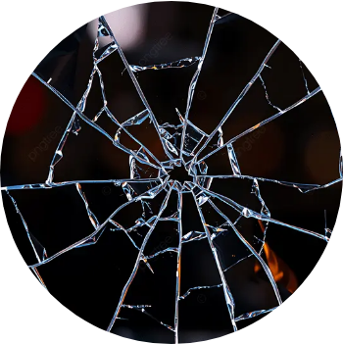
holiday.com
SHATTER
S.H.A.T.T.E.R. Framework
S — Strategic Mindset: View rejection as a data point in a volume game, not personal.
H — Hardened Resilience: Develop the "callus" to handle "no" without losing momentum.
A — Analyze the Interaction: Pinpoint the source of friction (timing, budget, or trust).
T — Target the Lesson: Isolate one key takeaway for the next lead.
T — Transform the "No": Pivot the follow-up strategy based on feedback.
E — Elevate the Approach: Sharpen your pitch using the learned insight.
R — Repeat & Refine: Re-engage with a more polished approach.

Slide 6
holiday.com
3. Empathy
OBJECTIVES
Play the S.L.O.T. Game
Understand we don't sell products; we solve problems.
Put yourself in the customer’s shoes.
Tailor solutions to specific pain points.
S — Solve, Not Sell: Product is a tool; solution is the goal.
L — Look Through Their Lens: Use empathy to understand their obstacles.
O — Orient to Pain: Map their struggles before proposing a solution.
T — Tailor the Hit: Customize the solution for their unique situation.

Slide 7
holiday.com
4. Deep Product Knowledge
OBJECTIVES
WE need to A.C.e. it
Know the features, benefits, and limitations inside out.
Answer questions with total confidence.
Anticipate concerns before the customer voices them.
A — Anticipate Friction: Predict objections. Seeing the "shatter" allows you to control the impact.
C — Command Details: Master features, benefits, and limitations. Total knowledge defeats customer doubt.
E — Execute with Confidence: Answer questions with precision. Authority stops customers from looking for the exit.

Slide 8
holiday.com
5. Adaptability
OBJECTIVES
Results V.a.r.y.
The sales landscape is constantly evolving.
Adjust your approach based on the client and the situation.
Learn quickly and pivot in real-time.
V — Vigilant Observation: Constantly scan the market and client needs; don't focus on the past.
A — Adaptive Maneuvering: Adjust your pitch in real-time until you find the fracture point.
R — Rapid Processing: Learn instantly from a "no" or hesitation; pivot immediately.
Y — Yield to the Facts: Accept the evolved landscape; abandon the old script and move with the new reality.

Slide 9
holiday.com
6. Positive Attitude
OBJECTIVES
light the F.U.S.E.
Maintain genuine enthusiasm for what you sell.
Transfer that excitement to the buyer.
Stay motivated through difficult deals.
F — Fanatical Belief: Be genuinely sold on your solution; your enthusiasm is contagious.
U — Underwrite the Energy: Control the room's emotional climate; be the source of the spark.
S — Spark the Buyer: Transfer your excitement and conviction until the buyer sees the value.
E — Enduring Drive: Sustain motivation throughout long, challenging deals; the grind requires constant fuel.

Slide 10
holiday.com
7. Time Management
OBJECTIVES
use our E.D.G.e.
Prioritize high-value activities that drive revenue.
Use all available tools to minimize friction and deliver quickly.
Dedicate specific time blocks for knowledge enrichment
and follow-ups.
E — Extract Value: Focus only on high-stakes, revenue-driving activities; ignore the noise.
D — Deploy Arsenal: Use all available tools (CRM, automation, AI) to reduce friction and deliver fast solutions.
G — Generate Flow: Schedule "Dark Time" for dedicated, uninterrupted knowledge enrichment and skill sharpening.
E — Enforce Follow-up: Maintain a disciplined schedule to ensure no lead goes cold and every detail is examined.

Slide 11








holiday.com
The DNA of a Top Performer
Communication
Positive Attitude
Persistence
WE DO WHATEVER IT TAKES TO GET A
100%
HIT
Adaptability
Empathy
HIT OUT ON SUCCESS
Time Management
Product Knowledge

Slide 12

holiday.com
the Secret Weapon IN your arsenal is to Become The Educator
Become an educator, not just a vendor.
Solve the problems of your "past self."
Earn authority by staying one step ahead of the journey.

Slide 13
holiday.com
SALES ASSASSIns Have the utmost integrity
“
A man's ambition should never exceed his worth. WE would do well to remember that
”
— The Harbinger, John Wick Chapter 4

Slide 14

holiday.com
TIme to wake up “tool master”
The White-Nosed Coatimundi
Organized number cruncher, great at quick calculations. Effective leader; uses tools like CRM and AI to advance deals. Wins through data, collaboration, and versatility. Expert at leveraging resources, using wit and calculation to close deals.
Let's see everyone's assassin aliases so we can get to know each other better!

Slide 15

holiday.com
“Wabi-sabi, a Japanese philosophy, involves restoring broken objects and enhancing their value by embracing the inherent beauty of imperfection.”
Pieces of the shattered “self” are always there whether put back together by gold or mud, we learn to live with the imperfections and appreciate its beauty.
ANY QUESTIONS?
PHILLIP.TAGARDA@kape.COM | #7deadlytraitsofasalesassasin
Thank you!

Slide 16
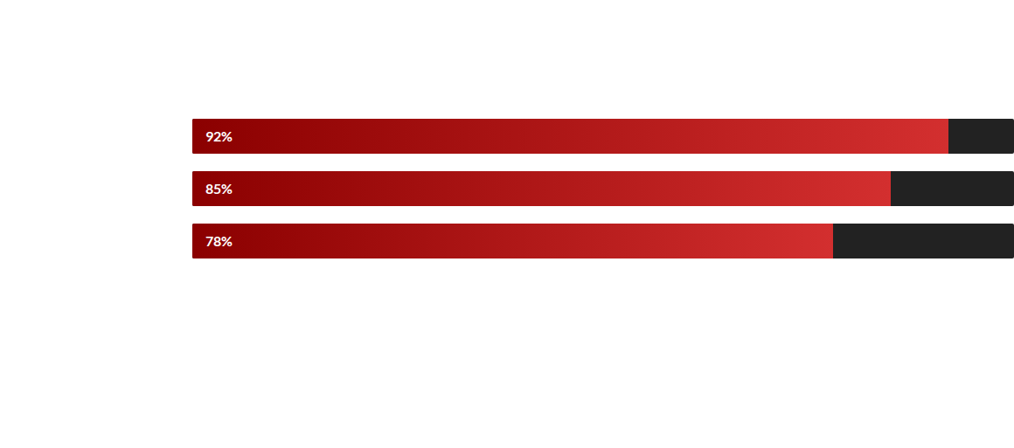
GENRE RESONANCE ANALYSIS
Audience engagement remains highest when the "Shatter Noir" aesthetic is applied consistently across all story beats.

Slide 17


PROJECT EVOLUTION
CONCEPT
FRACTURE
CONTRAST
IMPACT
Drafting the core noir narrative and "Shatter" themes.
Developing the visual motifs of broken glass and voids.
Finalizing the crimson-on-black color strategy.
Global launch and style guide dissemination.

